Slide 1

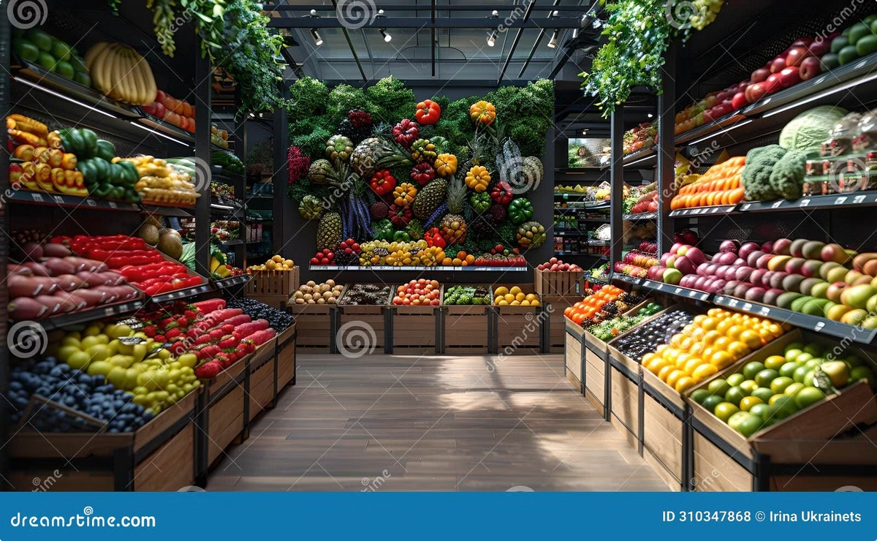

Introduction to Online Grocery Shop
Welcome to the exciting world of online grocery shopping! This presentation will guide you through the process of building a user-friendly and feature-rich online grocery store platform.
by Thapaswi Y

Slide 2
HTML Structure and Layout
Fundamental Structure
Layout and Design
Accessibility
The HTML structure provides the foundation for your website. Use semantic HTML elements like header, main, footer, and sections to organize content logically.
Consider using CSS Grid or Flexbox for responsive layout. Design a visually appealing interface with clear navigation, product displays, and shopping cart functionality.
Ensure accessibility by following web standards and using ARIA attributes for elements that need special attention. This makes your website usable for everyone.

Slide 3

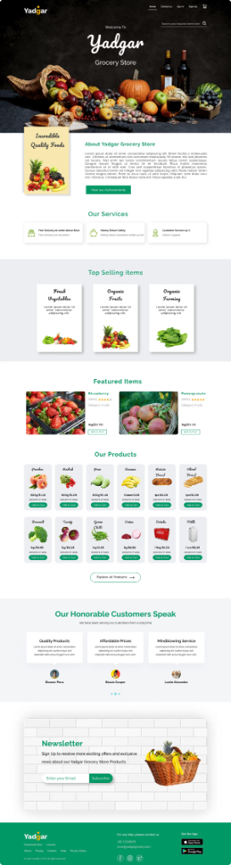
CSS Styling and Responsiveness
1
Visual Appeal
2
Responsive Design
Use CSS to style elements like fonts, colors, and spacing to create an attractive and engaging online shopping experience.
Ensure that your website adapts seamlessly to different screen sizes and devices for optimal viewing on desktops, tablets, and smartphones.
3
User Interface (UI)
4
Branding
Design an intuitive and easy-to-navigate UI that allows users to browse, select products, and complete purchases smoothly.
Apply your brand's colors, logo, and typography to create a consistent and recognizable brand identity.

Slide 4
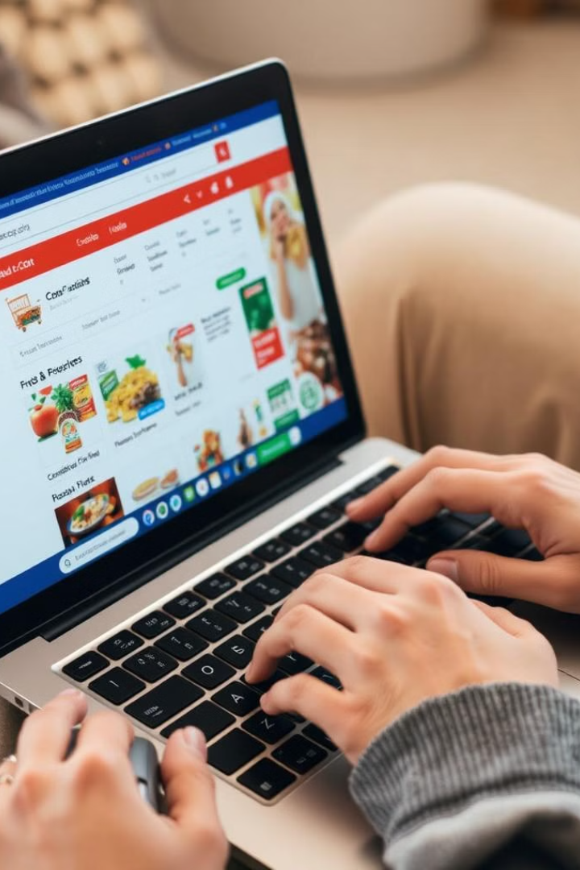



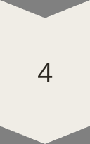
JavaScript Functionality
Product Filtering
Allow users to refine their search results by categories, price range, brand, or other criteria.
Dynamic Content
Use JavaScript to update website content dynamically, like displaying product details or updating the shopping cart.
User Interactions
Enhance user experience with interactive elements like product carousels, image zoom, and smooth transitions.
Form Validation
Validate user input on forms to ensure accurate information and prevent errors during checkout.

Slide 5

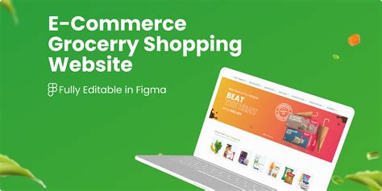
Product Catalog and Search
Feature
Description
Product Display
Showcase product images, names, prices, and brief descriptions in an organized way.
Search Functionality
Enable users to search for specific products by name, category, or keywords.
Filtering Options
Allow users to filter products by dietary restrictions, special needs, or desired characteristics.
Sorting Options
Offer options to sort products by price, popularity, name, or other factors.
Product Details
Provide comprehensive product information, including ingredients, nutritional values, and reviews.

Slide 6
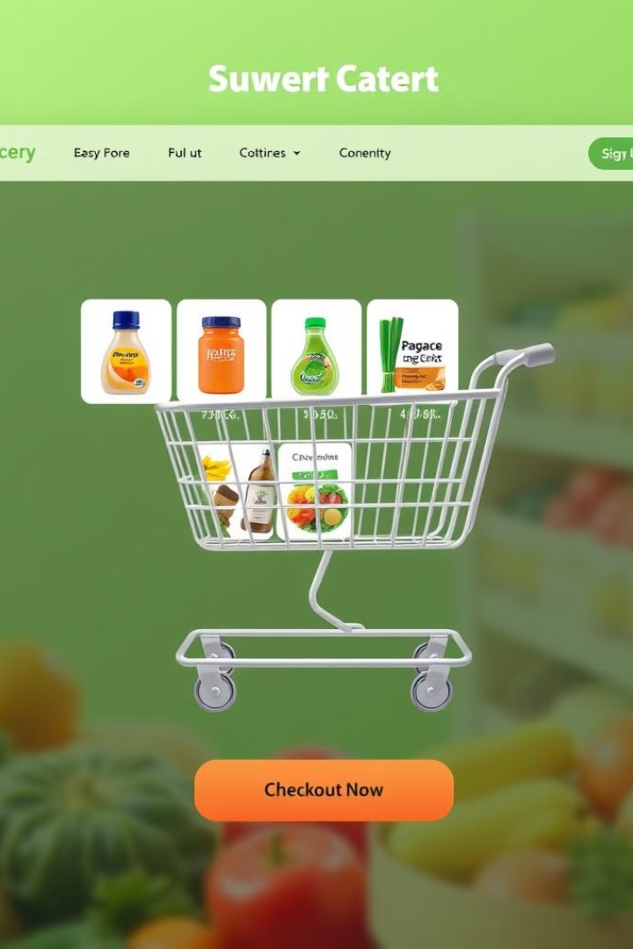




Shopping Cart and Checkout Process
Shopping Cart
Checkout Process
Allow users to add items to their cart, view the total cost, and modify quantities.
Guide users through a seamless checkout process, collecting their billing and shipping information.
Delivery Options
Order Confirmation
Offer a choice of delivery or pickup options, specifying delivery dates and time slots.
Provide a clear order confirmation with details, order status, and estimated delivery time.

Slide 7
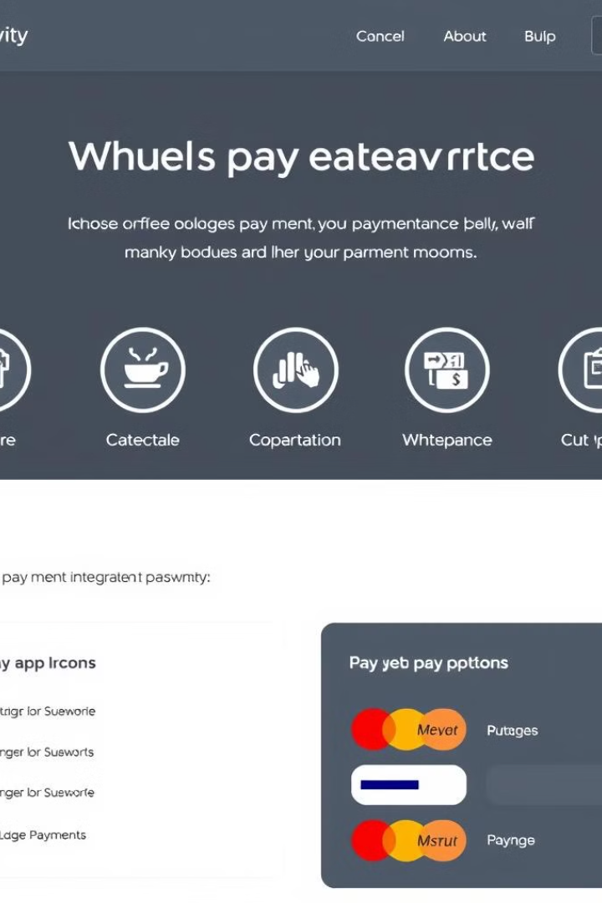
Payment Integration
1
Secure Payment Gateway
Choose a reputable and secure payment gateway to process transactions.
2
Multiple Payment Options
Offer a variety of payment methods, such as credit cards, debit cards, and digital wallets.
3
Secure Data Encryption
Ensure that all sensitive customer data is securely encrypted during transmission and storage.
4
Transaction Confirmation
Provide real-time transaction confirmation and receipts to users.

Slide 8

Conclusion and Next Steps
Developing an online grocery store involves careful planning, HTML structure, CSS styling, JavaScript functionality, product management, a smooth checkout process, and secure payment integration. By prioritizing user experience, accessibility, and security, you can create a successful platform that meets the needs of your customers.

